Slide 1
Amateur Radio Repeaters

Slide 2
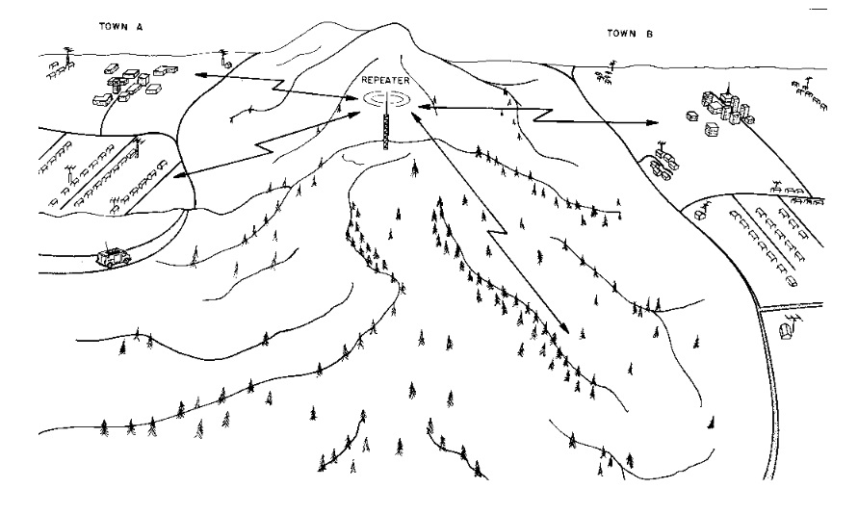

Slide 3
What is a repeater and when to use one?
A repeater consists of a transmitter and receiver on two different frequencies enabling it to transmit and receive at the same time. Now days it is usually all in the same box enabling the use of one antenna. if this is the configuration you will also need a set of duplexers on the TX output and RX input of the repeater going to the antenna.
Most mobile and handy talkies are relatively low power and have limited range. The repeater is usually located on a tall tower or building resulting in wide area local coverage. There are new digital modes that allow you worldwide communication. i.e. DMR, D-star, Fusion.

Slide 4
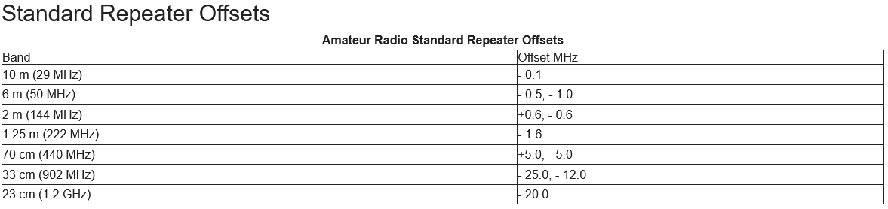

Slide 5
BAARC Repeaters
146.31/91mhz 88.5 PL tone Tiger Hill analog
145.45/144.85mhz ? KC5JKQ QTH digital
443.600/100mhz ? Hilton Garden Inn Fusion
444.00/900mhz none Tiger Hill analog
442.600/100mhz Asbury Church D-Star

Slide 6
How to you contact someone on a repeater?
1. Listen before you transmit. Then put out your call and the repeater freq,
i.e. this WB5UUW (mobile) listening on .91
or W5BM are you on freq.? this is WB5UUW
2. You do not have to ID on every transmission. Just every 10 minutes
and then at the end of your QSO.
3. If you want to join in a QSO in progress, say "break" between transmissions
and wait till they invite you to join in. Wait till you hear the timer "beep" on
each transmission. Otherwise the repeater will time out at the end of
three minutes. And it will be a few minutes before the repeater resets to
allow continued use. The repeater will ID in morse code when it resets
and every ten minutes when it is active. i.e. de W5DRZ

Slide 7
4. Doubling
If you are in a round table discussion using a repeater, to avoid 'doubling' (two or
more stations talking at the same time), make sure at the end of your over to hand
it to the next operator.
Example: W5BM to take it this is WB5UUW. If you don't do this it will end up in total
confusion as to whose turn it is.
5. Signal Reports
The only valid signal report that can be given on a repeater is to indicate that incoming
signal you are listening to is fully quietened. This means that there is no back ground
noise on the persons signal can be heard. Remember that the signal strength on your
radio is not an indication of the other persons signal but is an reading of how well you
can hear the repeaters output.

Slide 8
Some Common Q Codes Heard on Repeaters
QTH - What is your location? Or my location is
QSL - I understand or can you acknowledge receipt
QSY - I am changing frequency to, or can you change frequency to
QRZ - Who is calling me?
QRT - I am finished transmitting or please stop transmitting
QSO - Can you communicate Or I can communicate
QRM - I am experiencing interference (man made)
QRN - I am experiencing interference (natural)

Slide 9
THINGS NOT TO DO ON A REPEATER
1. Don't use 11 meter lingo. We are hams now. :) We don't use handles either.
2. Be mindful of your transmit button, be it on your mobile mic or the talkie on your hip.
We don't want to have to get out the direction finding equipment to find out who is
transmitting. If you time out the repeater it will be a while before it resets and
becomes available.
3. Don't talk directly into the mic. This usually causes audio to be distorted from
over modulating the RF output. Talk across the mic.

